Slide 1

POWER BI PROJECT
College Placement Analysis Dashboard
Summer Training — Power BI | CGC University Mohali
Presented by
Course
Guided by
Date
Himani Verma | 2405039451
B.Tech — CSE
Ms. Ashima and Ms. Mandeep
01St July 2026

Slide 2
Agenda
01
Problem Statement & Objective
06
Dashboard Walkthrough
02
Dataset Overview
07
Key Insights & Findings
03
Data Model — Star Schema
08
Publishing to Power BI Service
04
Power Query — Cleaning Steps
09
Challenges & Learnings
05
DAX Measures
10
Conclusion & Q&A
2 / 14

Slide 3
01 Problem Statement
What problem does this dashboard solve?
3 / 14

Slide 4
Problem Statement & Objectives
The Problem
Target User
Placement data was difficult to analyze using traditional spreadsheets, making it challenging to identify trends and factors affecting student employability.
Placement Officers and College Management who needed real-time insights into placement performance without manually analyzing spreadsheets.
Project Objectives
Connect & clean the raw dataset using Power Query
Design an interactive multi-page dashboard with 4+ visual types
Build a star schema data model with correct relationships
Publish the final report to Power BI Service
Create at least 5 meaningful DAX measures
4 / 14

Slide 5
02 Dataset Overview
Source, structure, and key fields
5 / 14

Slide 6
Dataset Overview
Kaggle
CSV
11,997
16
Source
File Type
Rows
Columns
Key Columns Used
Column | Role in Dashboard
student_id | Unique identifier for each student
degree | Used to compare placement trends across degree programs
cgpa | Used to analyze the relationship between academics and placements
placed | Used to calculate placement rate and placement status visuals
company_type | Used to analyze hiring trends across company categories
package_lpa | Used for package analysis and salary-related KPIs
Data Quality Steps (Power Query)
Verified that the dataset contained no duplicate records.
Confirmed that the dataset did not contain missing or null values in critical columns.
Changed data types (package_lpa, cgpa )
Created a custom column:
Placement Status
1 → Placed
0 → Not Placed
6 / 14

Slide 7
03 Data Model
Star schema design & relationships
7 / 14

Slide 8
04 Dashboard Walkthrough
Pages, visuals, and interactivity
11 / 14

Slide 9
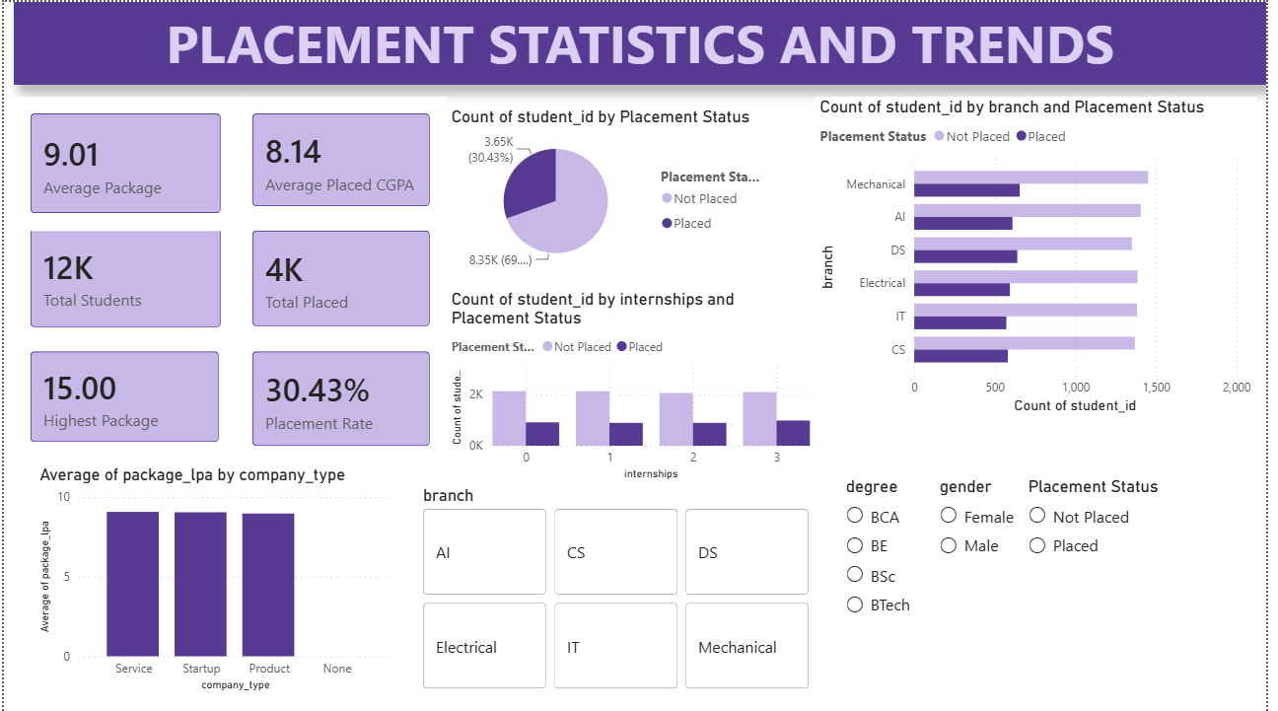
Dashboard — Page 1: Overview
Visuals on this page
KPI Cards — Average Package, Average Placed CGPA, Total Students, Total Placed Students
Pie Chart — Placement Distribution (Placed vs Not Placed)
Stacked Bar Chart — Placement by Branch and Placement Status
[ Screenshot — Overview Page ]
Column Chart — Average Package by Company Type
Slicers — Branch, Degree, Gender, Placement Status
Key Insight
The dashboard highlights key placement metrics, branch-wise performance, and salary trends while enabling interactive analysis through filters and slicers.
12 / 14

Slide 10
Key Findings & Insights
The overall placement rate was 30.43%, with approximately 3,652 students placed out of 12,000 students.
Students with internships and certifications demonstrated better placement outcomes compared to students without additional experience or credentials.
01
04
The average salary package offered to placed students was 9.01 LPA, while the highest package reached 15 LPA.
Product-based companies offered higher average salary packages compared to service-based companies and startups.
02
05
Students with higher CGPA generally received better salary packages, indicating a positive relationship between academic performance and placement outcomes.
03
13 / 14

Slide 11
Conclusion & Thank You
Successfully developed an end-to-end Placement Analytics Dashboard using Power BI to transform raw placement data into actionable insights.
The dashboard revealed a placement rate of 30.43%, an average package of 9.01 LPA, and highlighted the impact of academic performance and skill development on placement outcomes.
Implemented custom DAX measures, KPI cards, slicers, and interactive visualizations to enable dynamic analysis of placement trends.
Future Scope: Incorporate predictive analytics and drill-through functionality for deeper student-level placement analysis.
Questions & Feedback Welcome
14 / 14

